Slide 1

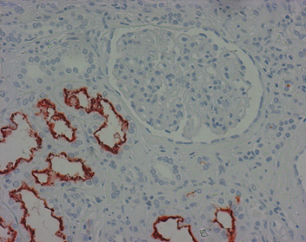
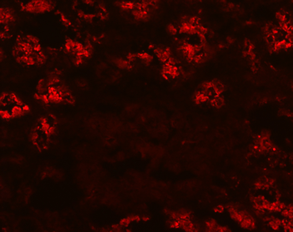
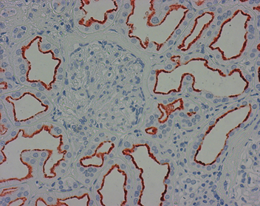
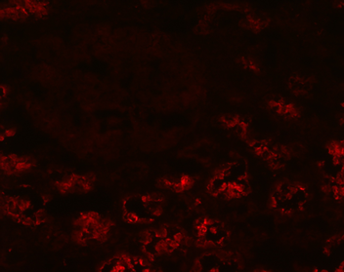
ReliaTech GmbH
Mouse anti-human Megalin (#CD7D5)
(Cat# 101-M144)
Figure 1: Staining (paraffin-embedded tissue-sections fixed in formalin) of Megalin in the brush border of the proximal tubule [Cat# 101-M144].
Figure 2: Immunofluorescence staining of Megalin in the brush border of the proximal tubule [Cat# 101-M144].
http://www.reliatech.de / orders@reliatech.de

